Slide 1
1. Main Screen Configuration
Caption Bar
Channel schedule time line
Device & SEC Status
Multi Channel Controller
12:00:00
Setting
-
X
Channel 1
OnAir
00:00:00:00
00:00:00:00
00:00:00:00
Time line
Device
SEC
Channel 2
OnAir
00:00:00:00
00:00:00:00
00:00:00:00
Time line
Channel 1
Channel 2
No | Type | Start Time | Duration | Title | Media | Device | Status
1 | T | 2017/05/24 10:00:00:00 | 00:30:00:00 | Title1 | P201703300001.mxf | Media1 | DONE
2 | S | 2017/05/24 10:30:00:00 | 00:25:00:00 | Title2 | P201703300002.mxf | Media1 | DONE
3 | S | 2017/05/24 10:55:00:00 | 00:20:00:00 | Title3 | P201703300003.mxf | Media1 | ONAIR
4 | S | 2017/05/24 11:00:00:00 | 00:05:00:00 | Title4 | P201703300004.mxf | Media1 | CUED
5 | S | 2017/05/24 11:05:00:00 | 00:30:00:00 | Title5 | P201703300005.mxf | Media1
6 | S | 2017/05/24 11:05:30:00 | 00:30:00:00 | Title6 | P201703300006.mxf | Media1
7 | S | 2017/05/24 11:06:00:00 | 00:30:00:00 | Title7 | P201703300007.mxf | Media1
8 | S | 2017/05/24 11:06:30:00 | 00:30:00:00 | Title8 | P201703300008.mxf | Media1
9 | S | 2017/05/24 11:07:00:00 | 00:30:00:00 | Title9 | P201703300009.mxf | Media1
Channel
status & time
PGM schedule list
PGM schedule time line

Slide 2

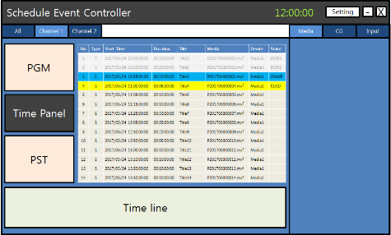
2. Device Configuration
Device
CG
Input
Current media name
Media current time
Media playback control
Current selected media folder
No | Name | Timecode | DCS
1 | DEC1 | 00:30:00:00 | DCS1
2 | DEC2 | 00:25:00:00 | DCS2
3 | DEC3 | 00:20:00:00 | DCS3
4 | CG1 | 00:05:00:00 | DCS4
5 | MSW1 | 00:10:00:00 | DCS5
Device list

Slide 3

4. CG Configuration
CG preview
Media
CG
Input
D:\Media\MXF\P201703300001.mxf
Current CG name
Current selected CG layer
1
2
3
Current selected CG folder
Folder
Folder name
File Name | Duration | Path
P201703300001.mxf | 00:30:00:00 | D:\Media\MXF
P201703300002.mxf | 00:25:00:00 | D:\Media\MXF
P201703300003.mxf | 00:20:00:00 | D:\Media\MXF
P201703300004.mxf | 00:05:00:00 | D:\Media\MXF
P201703300005.mxf | 00:10:00:00 | D:\Media\MXF
CG list

Slide 4
5. Input Configuration
CG preview
Media
CG
Input
Video & Audio device name
Current input device name
Input information
Input information

